Slide 1

Viewing Quasar 3C286 through GMRT
A presentation by Group 4:
Shubham Kejriwal
Kritti Sharma
Achyut Kaushik
Aman Kumbhakar
Faculty Mentor: Ms. Suman Garia
IUCAA RAWS 2020

Slide 2
Contents
Introduction
Preliminary Analysis
Spectral Analysis
Statistical Inference
Conclusion and Future prospects

Slide 3
Introduction to the Data
Source: Quasar 3C 286 [1] -
Towards constellation Canes Venatici
Apparent Mag = 17.25
z ~ 0.85
4 pairs of data from GMRT antennae C11 and C12 in frequency bands B3 (300-500 MHz) and B5 (1050-1450 MHz). (Total 8 files)
Time series data with 1024*4096 elements in each file (1D array).
[1] from Simbad Database

Slide 4
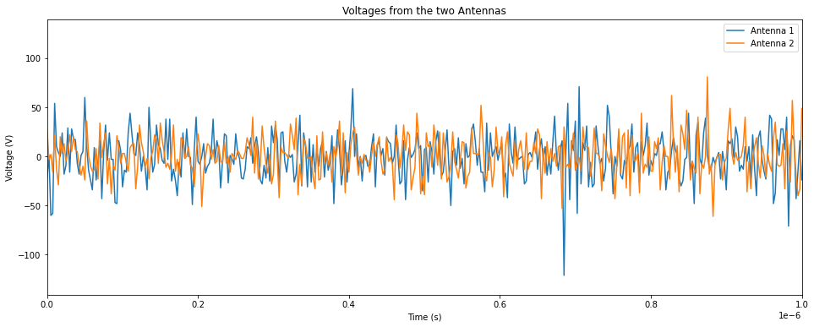
Time Series Visualization
Analysis on C11/12_..._B3 data

Slide 5
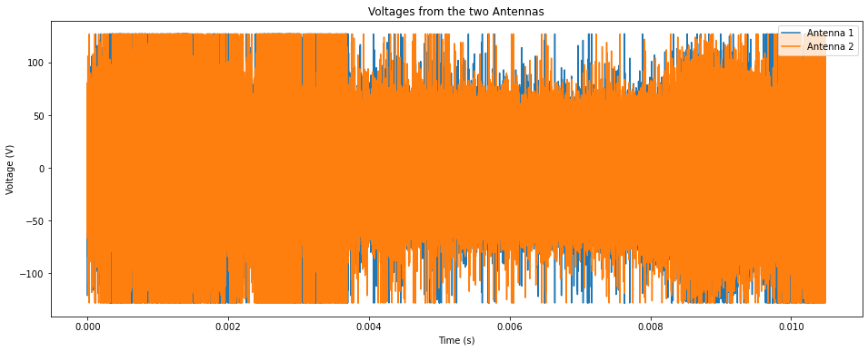
Time Series Visualization - Complete Dataset
Analysis on C11/12_..._B3 data

Slide 6
Time Series Visualization - Complete Dataset
Comments…
Data from both antennae almost perfectly overlapping.
Small discrepancies because of instrumentation/RFI.
Fix? Techniques such as cross-correlation (later).

Slide 7
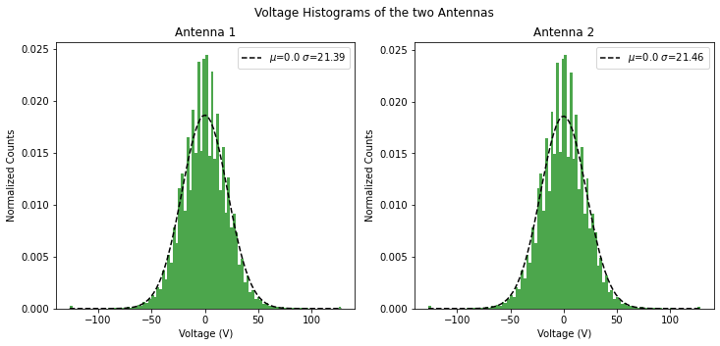
Voltage Histograms Fitted with a Gaussian
Analysis on C11/12_..._B3 data

Slide 8

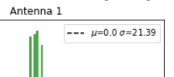

Voltage Histograms: DC Offset Correction
Step 1: Fit a Gaussian to Voltage Histograms. Extract mean and std.
Step 2: Subtract data by the mean.
Step 3: Fit a Gaussian to corrected Voltage. Extract mean and std.
Implemented verbose
Analysis on C11/12_..._B3 data

Slide 9
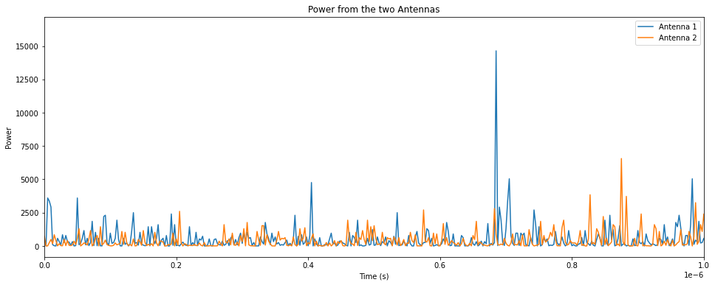
Voltage^2 visualization
Analysis on C11/12_..._B3 data

Slide 10
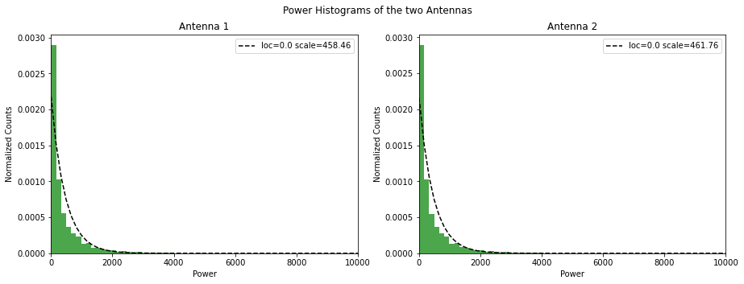
Voltage^2 Histograms Fitted with an Exponential
Analysis on C11/12_..._B3 data

Slide 11
Spectral Analysis - The Dynamical Spectrum
Reshape to 1024 x 4096
Data given as an array of 4194304 elements
Obtain power* along each frequency channel
FFT along the columns
Frequency Spectrum (2048 chans)
Power Spectrum (2048 chans)
Time Series
1024
Time Series
1024

Slide 12
Spectral Analysis - The Dynamical Spectrum
Power Spectrum for each time series
Power Spectrum (2048 chans)
Average over some frequency channels to obtain better SNR
Time Series
1024
Averaged Power Spectrum
Power Spectrum (2048/avg chans)
Ready to Plot as a dynamic spectrum!
Time Series
1024

Slide 13
Spectral Analysis - The Dynamical Spectrum
* Obtaining power from the frequency spectrum (FS) can be done in two ways:
Correlating the FS from one antenna with itself (Auto-correlation).
Correlating FS from one antenna with the other (Cross-correlation).
Both have been explored below.

Slide 14
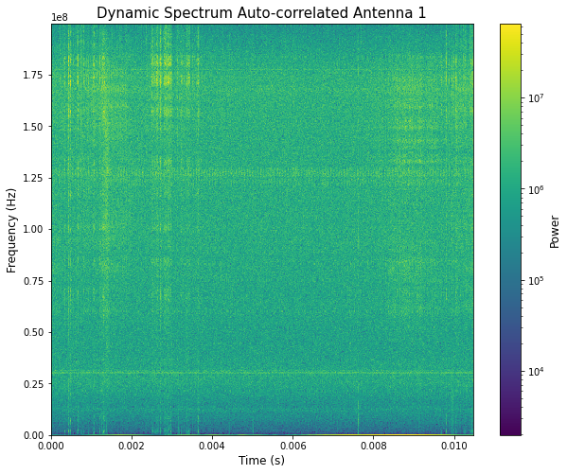
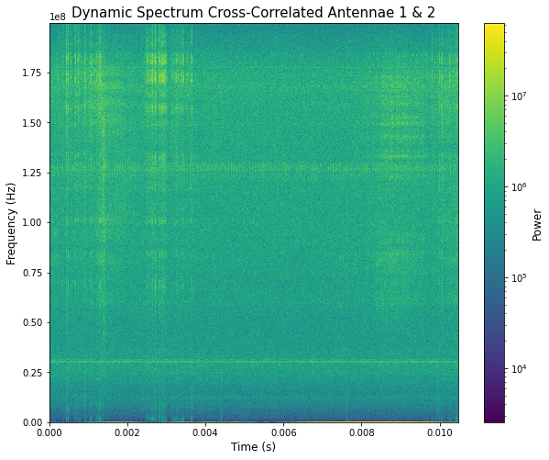
Spectral Analysis - The Dynamical Spectrum
Analysis on C11/12_..._B3 data

Slide 15
Spectral Analysis - The Dynamical Spectrum
Inference:
Cross-correlation DynSpec was comparatively smoother.
Signature features of the DynSpec more prominent for cross-correlation.

Slide 16
Spectral Analysis - Power Spectral Density
Averaged Power Spectrum
Power Spectrum (2048/avg chans)
Power Spectrum (2048/avg chans)
Time Series
1024
(Can now be plotted against freq)
Taking the mean along all rows for a fixed frequency channel gives the PSD.
“Squeezing the Dynamical Spectrum along time axis.”

Slide 17
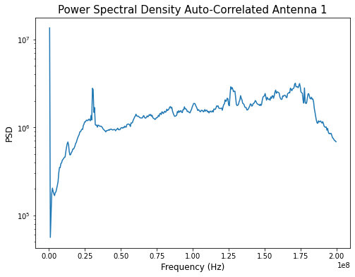
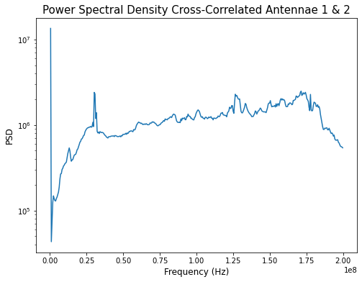
Spectral Analysis - Power Spectral Density
Analysis on C11/12_..._B3 data

Slide 18
Spectral Analysis - Power Spectral Density
Inference:
Noted a suppression of power in the cross-correlation PSD.
Can be related to noisy time-series components averaging to ~0
(happens in both correlations, but better in cross-correlation).

Slide 19
Basic Statistics of the data
Averaged Power Spectrum
Power Spectrum (2048/avg chans)
Power Spectrum (2048/avg chans)
Time Series
1024
(Can now be plotted against freq)
Averaging along time-axis can be done as mean or rms. We thus obtain the observed mean and rms PSD.
Expected rms can be obtained as mean/sqrt(2*1024*dt*df) where dt = 1/(2*bandwidth) and df = bandwidth/(no. of channels).

Slide 20
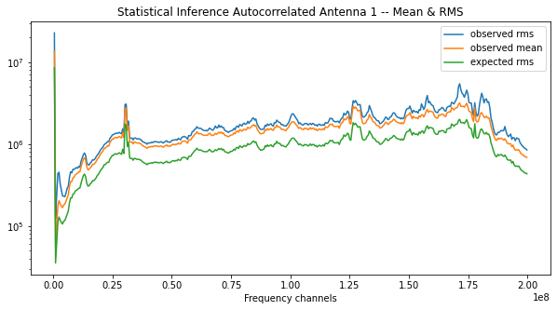
Basic Statistics of the data - mean & rms
Analysis on C11/12_..._B3 data

Slide 21
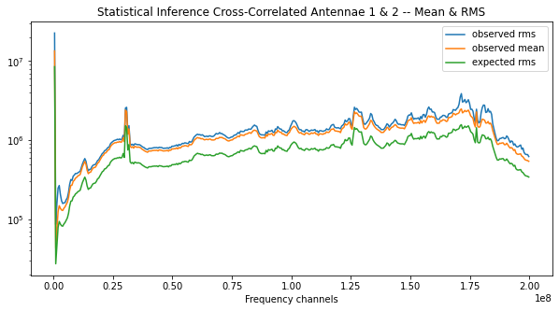
Basic Statistics of the data - mean & rms
Analysis on C11/12_..._B3 data

Slide 22
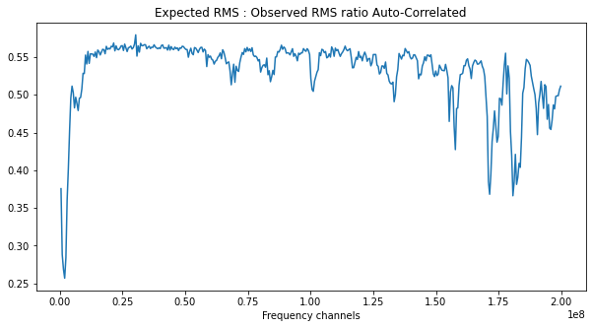
Enhancing relation b/w expected and obs rms
Analysis on C11/12_..._B3 data

Slide 23
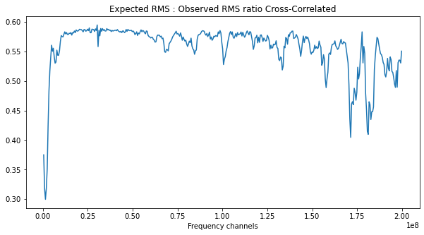
Enhancing relation b/w expected and obs rms
Analysis on C11/12_..._B3 data

Slide 24
Enhancing relation b/w expected and obs rms
Inference:
An overall suppression of power again noticed in cross-correlation for statistical plots. This corresponds to reduction in independent instrumental noise due to the combination of data points from both antennae.
For the ratio of expected to observed RMS, we received a value closer to 1 for cross-correlated dataset compared to the auto-correlated one. I.e. the two mach better for cross-correlation.

Slide 25
Identifying high RFI channels
Frequency channels with a high RFI can now be identified using the plot for ratio of expected to observed rms.
Step 1: Set an educated threshold on the minimum acceptable ratio (MAR) in range (0,1) from the expected to observed rms spectrum.
Step 2: Every channel for which the ratio is >= MAR has acceptable RFI. Every channel with ratio < MAR is a high RFI channel and can be excluded from the data analysis process.

Slide 26
Importance of datapoint values and signature
Datapoints have two components - absolute value and sign.
Following test was conducted to infer the relative importance of each component in drawing inference from obtained data.
Dynamical Spectra and mean & rms spectra were obtained for value-only and sign-only datasets.
Obtaining signs only (Simple loop):
If data element > 0: data element <= +1
If data element < 0: data element <= -1
Else data element = 0
Obtaining absolute values only:
Data_abs = numpy.abs(data)

Slide 27
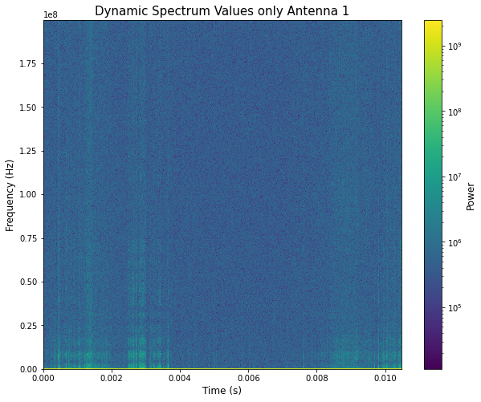
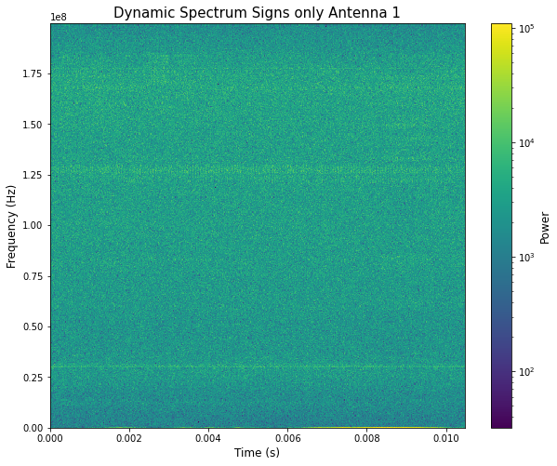
Importance of values and signs: DynSpec
Analysis on C11/12_..._B3 data

Slide 28
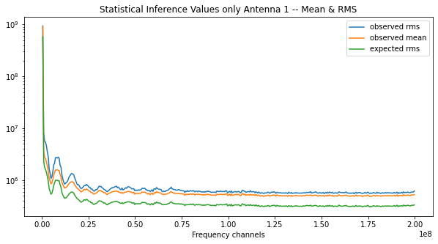
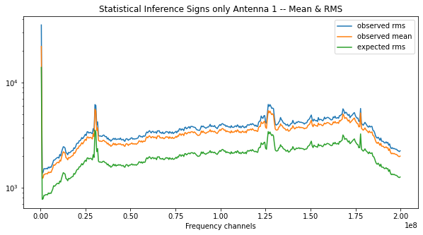
Importance of values and signs: PSD
Analysis on C11/12_..._B3 data

Slide 29
Importance of datapoint values and signature
Inference:
Signs-only PSD & Dynamical Spectrum closely resembles one obtained from original data. Values-only PSD infers nothing.
Clearly, signs are more important components for a spectral analysis.

Slide 30
Conclusion
Analysis of data produced by GMRT for quasar 3C286 produced non-random frequency characteristics. (if purely random, PSD would be approximately constant across all channels).
Cross-correlation of data from two antennae helps improve SNR and suppress instrumental noise.
While, both, absolute values and signs are important for DynSpec, sign is more crucial in PSD preparation.

Slide 31
Future Prospects
Streamlining of the written code - making it modular, user friendly, and efficient.
Analysis of obtained PSD to interpret 3C 286 and the interstellar/intergalactic medium.
Comparison of other pairs of data. Cross-comparison of different pairs.

Slide 32
Thank You

